Slide 1

Year 12
Information Night
2024

Slide 2
Welcome
Mrs Krysty Connelly
Year 12 Coordinator

Slide 3
AGENDA
Topic Speaker
Welcome Mrs Krysty Connelly Year 12 Coordinator
Respect, Resilience and Responsibility Mr David Thomson
Principal
Notification of 2023 Year 12 results Ms Leanne Krosch
Study expectations/organisation Deputy Principal Senior Schooling
Academic Coaching process
Student options for 2024 & beyond Mrs Bec Zischke
QTAC Information Guidance Officer
Student wellbeing
Senior Formal / Graduation Mrs Krysty Connelly Year 12 Coordinator
Question time & conclusion Mrs Krysty Connelly Year 12 Coordinator

Slide 4
Mr David Thomson - Principal
Responsibility – Do the best that you can do
Respect – Be the best you can be to others
Resilience – Be the best you can be to yourself

Slide 5
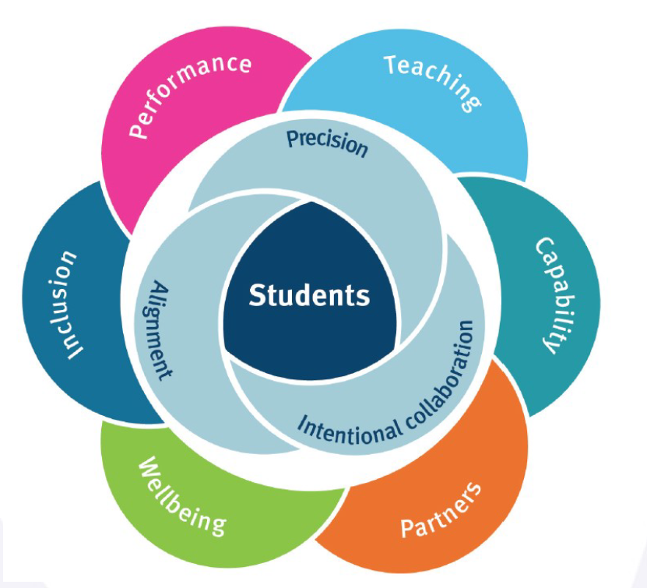

Kingaroy State High School
Resilience – taking deliberate actions to work together, learn together and improve together.
Respect – everyone feels welcome and like they belong.
Responsibility – to make this school, an extraordinary place to learn and work.
“Getting the culture right is pivotal. With the right culture the strategies that are used become less important. The culture is set by the way that the adults behave.”
- Paul Dix

Slide 6
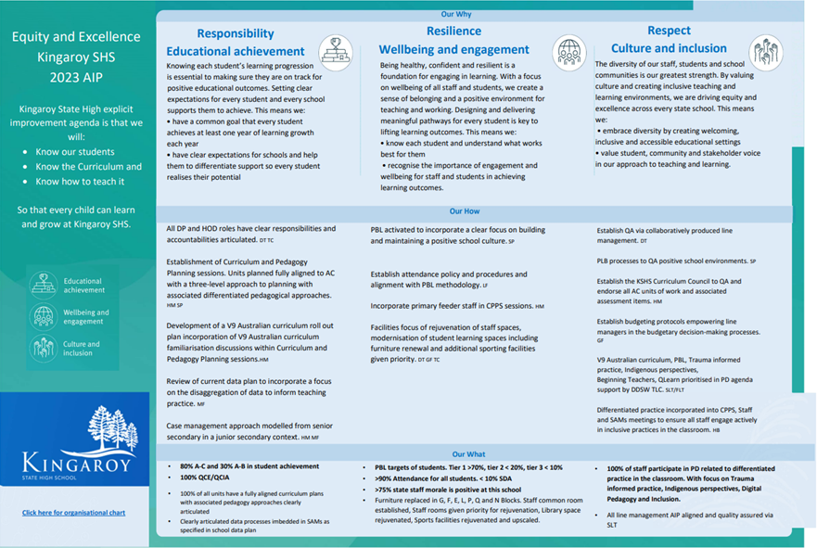

Slide 7
Ms Leanne Krosch
A/Deputy Principal
Senior School

Slide 8
2024
100%
QCE and QCIA achieved by our students
From 2019-2023, only 1 student did not leave Yr 12 with the QCE

Slide 9
ATARs
From 2024

Slide 10
Charlotte 99.8
Vivien 95.7
> 95 : 2
>90 : 3 9.8% of students above ATAR of 90
>85 : 7 23.5% of students received an above ATAR 85
>80 : 8 39.2% of students received an ATAR above 80
>75 : 8
>70 : 7
30 students have accepted university offers
OP 1

Slide 11
REVIEW OF
NEW
QCE

Slide 12
A few reminders

Slide 13
Best ATAR “99.95”
Down to
“below 30”

Slide 14
ATAR calculated on
: 5 best General subjects
Or
: 4 General subjects + 1 Applied subjects
Or
: 4 General subjects + 1 Certificate III

Slide 15
General subjects have external exams at the end of Year 12.
Maths and Science subjects 50% External exams
All others 25% External exams

Slide 16
Must “pass” General or Essential English to be awarded an ATAR

Slide 17
Year 11 & 12 subjects comprise 4 Units of work
Unit 1 & 2 : formative for ATAR count for QCE
: students finished Unit 2 at the end of term 3 2023

Slide 18
Units 3 & 4 : Summative for ATAR
: Used as a pair for QCE
Students complete 3 Internal Assessments and 1 External Assessment for General Subjects
Students complete 4 Internal Assessments for Applied Subjects

Slide 19
Students started Unit 3 at the beginning of term 4 2023.
Complete Unit 3 at the end of term 1 this year
Unit 4 will start at the beginning of Term 2, 2024

Slide 20
BLOCK EXAM PERIODS
The last Year 12 block exam period will be conducted in Week 10 this term
External Exam block
Week 4 Term 4 – Monday 21 October – Tuesday 12 November, 17 days

Slide 21
MOCK BLOCK
To assist students in preparing for the External exams,
we will be running a Mock Block.

Slide 22
Features
Run from Monday 2 September to Friday 4 October (Week 9 & 10 Term 3 and Week 1 Term 4)
Students will be in classes at this time and exit to sit the mock exam
Our mock block schedule will mirror image (as closely as possible) the External Block Exam Schedule

Slide 23
Support Provided
2023: Elevate Education : Time Management
2024: Elevate Education: Ace your exams
Staff: Mrs Zischke -Guidance Officer - Student Services
Mrs Kempson - HOD: Senior Schooling - Community Building
Mr Rob Turner- HOD: Health and Physical Education - Indoor Sports Hall
Mrs Connelly- Year 12 Year Level Coordinator - Indoor Sports Hall
Mrs Hourn - Senior Schooling - Admin - Community Building

Slide 24
Year 11 has been FORMATIVE,
that is,
a year of practice

Slide 25
Unit 3 & 4 Assessment Process
School writes the assessment
ENDORSED (QCAA Process)
Return to school
Students complete assessment
Our teachers mark
QCAA request a sample of several students’ work (QCAA Process)
Students’ results are
CONFIRMED (QCAA Process)

Slide 26
KSHS has
Lead Confirmer
Confirmers
Endorsers
Markers

Slide 27
Study
Expectations / Suggestions /
Wellbeing / Staying Healthy

Slide 28
1½ - 3 Hours
Per Night

Slide 29
Make the time
COUNT

Slide 30
In a three hour slot:
1. Write down the sequence of your tasks to do (suggest do your LEAST favourite subject first)……..prioritising

Slide 31
2. Focus on ONE
task at a time

Slide 32
3. Log out from all your social networks
in order to eliminate distractions

Slide 33
4. Drink lots of water.
Avoid soft drinks and
high sugar drinks

Slide 34
5. Clean your room & study desk:
6. Reward yourself every 45 minutes
- Phone time
- TV time
- relax time
for about 10 minutes

Slide 35
Things to Monitor :
Part time work hours – 12 hours/week (Current students will have a working life until they turn 70…. No need to go over the top now)
Level of Socialisation (particularly with drivers’ licences)
Too many extra curricular activities, or not enough ……… keep it healthy
Amount of sleep (8 hours / night still recommended)
Xbox/ play station/ phones/ You tube/ Netflix need managing

Slide 36
Academic Coaching
Process

Slide 37
Process started in 2019 with all Year 11 students
being assigned an
Academic Coach
(a member of staff/form teacher)

Slide 38
This process will continue to run this year.
It is a conversation:
Always supportive
It’s a touch base (How are you going/are you worried about anything)
Focus on goals
Looks at QCE or other issues
Once a term or semester. However, students can see their coach at any time.
Senior Review team checks after each assessment task in Yr 12, and will meet with any students who may need extra support to achieve their QCE

Slide 39
How can you help?
Be aware of the assessment calendar and subjects your Year 12 is studying
Monitor those things mentioned before
Be prepared to say NO
Be aware of the QCAA process for Illness & Misadventure regarding assessment due dates, absences on the day of assessment etc.
Contact us if you are concerned about anything
*No family holidays during assessment period*

Slide 40
Chat GPT
What is it?
It is a Chatbot powered by artificial intelligence
You can have a conversation with it, prompt it to write essays, make medical diagnoses etc.
It is powered by large amounts of data and computing techniques to make predictions to string words together in a meaningful way

Slide 41
5. It is not google!
6. It will produce inaccurate answers / responses
7. The work a student submits must be their own.

Slide 42
Looking forward
to the rest of 2024!

Slide 43
Mrs Bec Zischke
Guidance Officer

Slide 44
Post School Options
WORK - Full Time, Part Time
APPRENTICESHIP/TRAINEESHIP – consider some work experience this year, ‘build’ your CV
STUDY - Full Time, Part Time
  University, TAFE, Private Providers
  Beneficial to start looking at scholarships now to ensure you meet criteria
GAP YEAR - Work, Volunteering, Defence Force
  (Defence Force Gap Year applications now open)

Slide 45
Beyond School: What student’s receive
Mid November – Kingaroy SHS
  School Reference (if requested)
  Graduation Certificate
Mid December – QCAA
  Student Education Profile - Students in Queensland are issued with a senior education profile upon completion of Year 12. Included in this profile could be:
  * Senior Statement (transcript of learning)
  QCE or QCIA
  (student need to create an account on the QCAA Student Learning Portal)

Slide 46
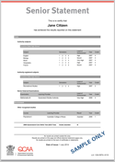
Senior Statement
A transcript of the learning account for all students completing Year 12 at a Queensland School. The Senior Statement shows all studies and the results achieved that may contribute to the award of a QCE.

Slide 47

Qld Certificate of Education
The Queensland Certificate of Education (QCE) is Queensland's senior school qualification, which is awarded to eligible students, usually at the end of Year 12.

Slide 48

Qld Certificate of Individual Achievement
The Queensland Certificate of Individual Achievement (QCIA) recognises the achievements of students who are on individualised learning programs. To be eligible, students must have impairments or difficulties in learning that are not primarily due to socioeconomic, cultural or linguistic factors.

Slide 49
Q T A C
Qld. Tertiary Admissions Centre
Calculate the students ATAR
Publishes just before Christmas
First Round Offers early January 2025*
Students need to create an account on the QTAC ATAR Portal

Slide 50
Early Offer Guarantee
Early Offer Guarantee gives you the chance to receive an offer to study at selected Universities as early as August, long before ATARs and final results are released so you can head into your final school exams knowing you’re sorted for 2025.
The offer is made based on the schools recommendation and is independent of your Year 12 results.
You still need to meet the prerequisites and other program-specific requirements for your chosen degree.

Slide 51
Early Offer Guarantee
19 Students received an Early Offer into University studies for 2024
Process = students complete the relevant application form -> see / discuss with Mrs Zischke -> Mrs Zischke and Ms Krosch consult / consider / quality assure suitable applicants -> approved by Mr Thomson
Not all Unis offer Early Offers and their processes differ, please visit the individual Uni webpage to find out more.
Applications will open on the first Tuesday of August.

Slide 52
Taking care of YOU!
Year 12 can be a Rollercoaster of emotions – for parents and students alike! It is important to check in with each other, look out for each other and take care of each other and yourselves.
Guidance Officer support available
Useful Websites:
    Youth beyondblue
    ReachOut.com
    Bite Back
Useful Apps:
    Smiling Minds – Mindfulness meditation
    Music eScape – Users can match their music to their mood to create a ‘music journey’
    Moodkit – Activities to improve your mood
    Breakup Shakeup – Helping young people cope with a break up

Slide 53
Emails:
Please check these! Students and parents/carers are welcome to email me. rzisc4@eq.edu.au
Questions:
Feel free to see me at the conclusion of the evening, or appointments can be made via email or Student Services ☺

Slide 54
Mrs Krysty Connelly

Slide 55
Senior Formal
Thursday 14 November
Ms Emily Follett
Formal Coordinator

Slide 56
Continued on next slide

Slide 58
I wish all students a successful and memorable year.
Hope to see you all there.
Introductions and Questions

